Slide 1
Wednesday 4/20

Slide 2
http://www.nbc.com/saturday-night-live/video/guns/2919732 (1:36)
https://youtu.be/8cwKZ8XjhHI (1:01)
https://youtu.be/dylLEfDhb1U?list=PL3F8484DB388E77AC (4:17)
https://www.washingtonpost.com/news/the-fix/wp/2012/12/19/a-gun-ownership-renaissance/

Slide 3
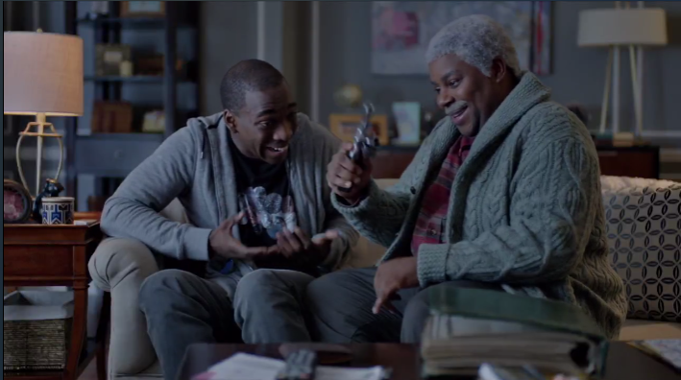
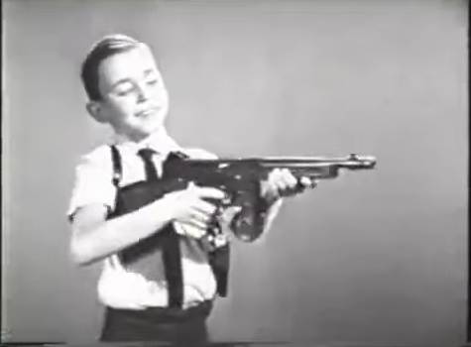
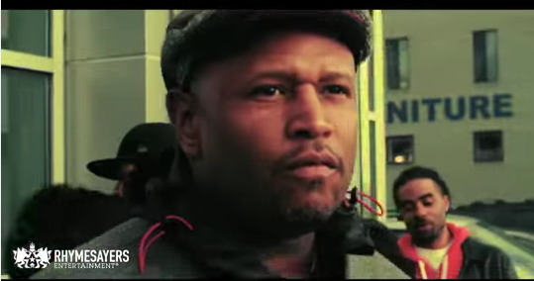
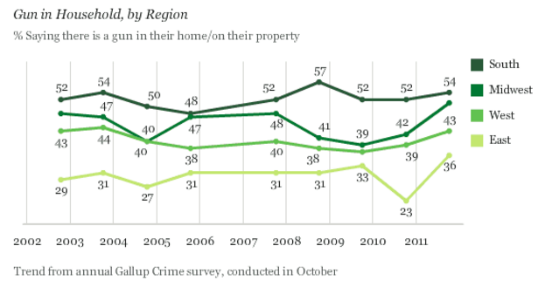
What period in history does this source roughly represent?
What does it say about the state of the gun control debate and the role of gun ownership in America? What and whose attitudes does it represent?
How might this relate to conversations about gun control in the U.S. right now?
How does the source medium contribute to or change its argument or meaning?
Above Left: SNL
Middle: Tommy Gun toy
Left: WaPo charts
Above: I Self Divine

